Slide 1
CORA Workflow
Famke Kraaijeveld, PTI/RC

Slide 2
Some Statistical definitions
Risk = probability of failure * consequence
Opportunity = probability of success * consequence
Reliability = probability of non failure
Reliability Index = Number of standards deviations away from failure plane
Stochast = random variable
Probability Distribution Function (PDF) = function that describes the likelihood of stochast falling into a particular range. Integral over the function is 1.
Cumulative distribution function (CDF) = function for stochast that describes likelihood of values <= X)
u-space: Normal standard distribution space, sampling occurs in this space.
Correlation = statistical relationship involving dependence (in CORA this is for the u-space)
Fragility = degree of dependence of reliability on a stochast

Slide 3
Some mechanical definitions
Object = Volume or area of interest, e.g. specific well or formation
Component = Object with associated failure mechanism
Failure mechanism = Type of failure, e.g. shear failure, tensile failure
LSF = Limit State Function, mathematical definition of failure, LSF <=0 is failure
Formation = volume associated with single rock or source
Fault = 3-D plane of weakness
Well = 3-D line graph

Slide 4
Default settings
In the settings sheet the default systems settings are loaded upon first install. You can change these and save them.
Note 1: QuickBlocks comes with a python installation. A separate python distribution is not required for executing user models in python.
Note 2: Use the Verbose setting to minimize logging (0), to use medium logging (1) or maximize logging (2)
Sheet | Key | Value
Cora | Path cora application | C:\Program Files\GEOMEC 5.3 - SVS\CORA\Binaries
QuickBlocks | Python path | C:\Program Files\QuickBlocks 2.2\python.exe
QuickBlocks | QuickBlocks path | C:\Program Files\QuickBlocks 2.2
QuickBlocks | QBpythonCore | C:\Program Files\QuickBlocks 2.2\python.exe
Cora | Verbose | 1
GeoMec | GEOMEC path | C:\Program Files\GEOMEC 5.3 - SVS
UserModel | UserModel path | C:\Program Files\QuickBlocks 2.2\python.exe
GEOMEC | SaveAllCoraInput | TRUE
GEOMEC | SaveAllModelResults | FALSE
GEOMEC | SaveModelResultsFailedCases | FALSE
GEOMEC | SaveInputFilesFailedCases | TRUE
Cora | NumberOfCores | 2
FIST | SaveAllCoraInput | FALSE
FIST | SaveAllModelResults | FALSE
FIST | SaveModelResultsFailedCases | FALSE
FIST | SaveInputFilesFailedCases | TRUE
FIST | FIST path | C:\Program Files\FIST-6.6

Slide 5
The actual workflow

Slide 6
General workflow
Approach:
Model & Case definition
Build & Run Proxy
Quick screening
Reliability calculation
Reliability evaluation
Engines:
Geomec
QuickBlocks
Geertsma
User defined
Distributions:
(Truncated) Normal
Lognormal
Uniform
Proxy functions:
First order P10-P50
First order P50-P90
First order double
Second order
Experimental design
Scenario table
Tornado plot
Coefficients plot
On engine, proxy or mixed mode
Crude Monte Carlo
MC Importance sampling
MC Directional sampling
FORM
Component reliability
System reliability
Design point
Fragility curve
Sampling data
Notes:
The course will touch upon the different methods implemented and the workflow of CORA

Slide 7
General workflow
The suggested workflow is indicated by the sequence of sheets.
Define your model according to specifications
Open CORA project
Define uncertainties & failure model; check input
Use quickscreening to select key uncertainties and failure mechanisms
Do reliability analysis with or without proxys
Methodologies in CORA such as PDFs and reliability methodology, including input description, can be found in CORA methodologies.pptx
  Note: general name convention: avoid characters like .,(). This may lead to unexpected results

Slide 8
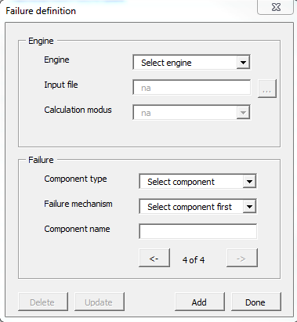
Define CORA model
The CORA model including base case file, objects of failure and failure mechanism are defined here.
Step 1: Choose your engine
Step 2: UserModel & Geomec: Browse and select model
Step 3: Select component type and failure mechanism
Step 4: Give a <Component name> (name will be used as indicator throughout analysis)
Step 5: Press <Add>. Repeat 3-5 until ready
Step 6: Press <Done>
Note 1: failure mechanisms can also be added in the table directly after loading one mechanism.
Note 2: Add all mechanisms you want to include as you cannot add them later without cleaning subsequent sheets.

Slide 9
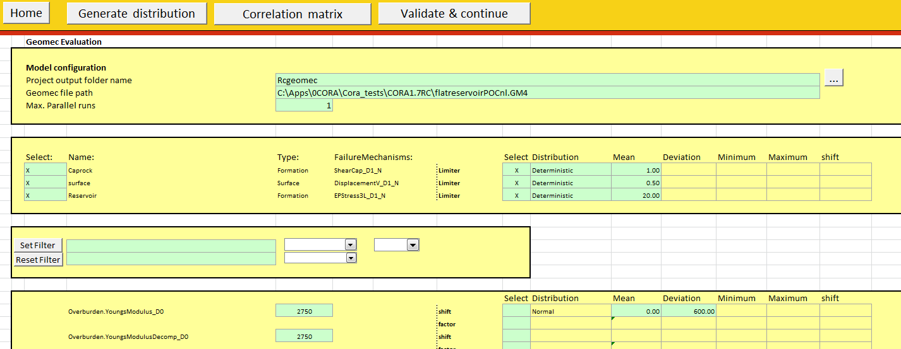
Define basecase and uncertainties
Step 1: Fill in calculation path and number of parallel threads
Step 2: Fill in the base case values (default deterministic)
Step 3: Define the uncertainty distributions and correlations
Step 4: Define min, max and step size for the control parameters (reliability analysis) when wanted
Step 5: When satisfied press <Validate and continue>
Note: Upon validation the calculation folder is made and settings are saved.

Slide 10
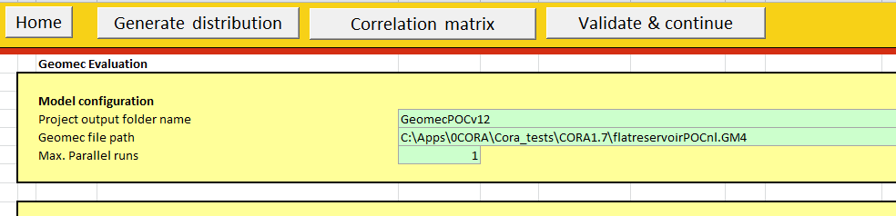
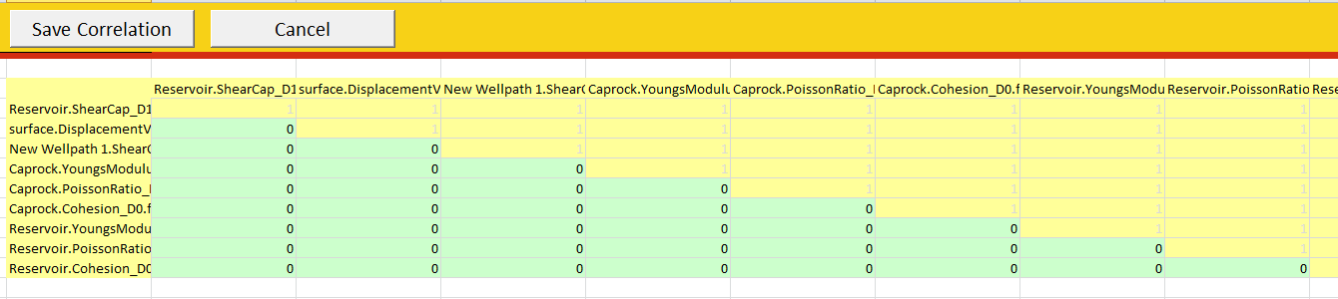
New Correlations input screen

Slide 11
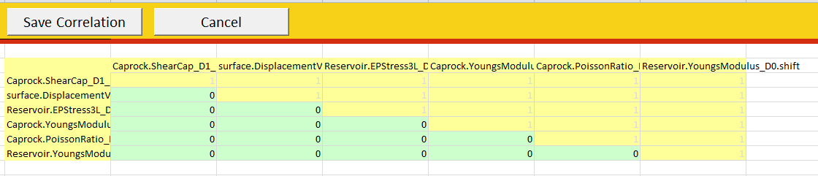
Add correlations
  Correlations are added by pressing <Correlation matrix>.
  You can move columns to fit to view.
  Numbers are entered in the green areas.
  Numbers are stored after pressing <Save Correlation>.
  Note:
  The upper right side of the matrix is automatically filled by CORA kernel.
  The correlation matrix is required to be positive definite. This can be challenging when having multiple (> 2) stochasts correlated

Slide 12
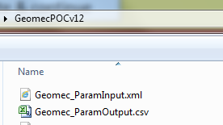
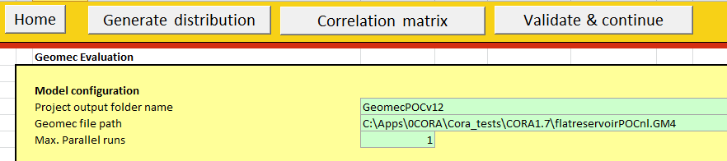
Check distributions
  On model sheet:
  Export single distributions to csv and view in tab <csv viewer>
  <Not yet available> Export correlations to csv
  On Scenario sheet
  Do a double order proxy <Scenario Table> to check ranges of values used

Slide 13
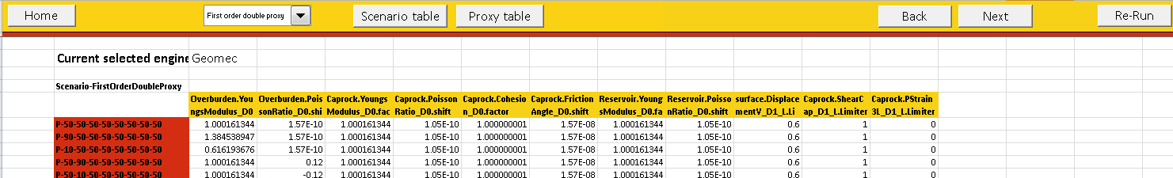
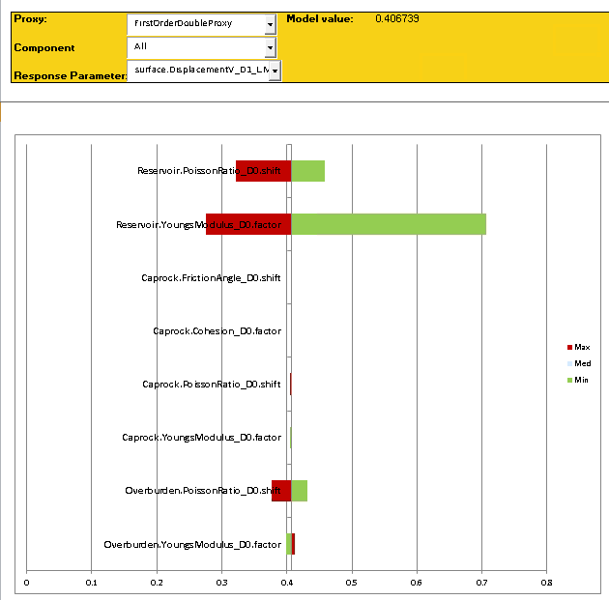
Quick Screening
Now the iterative process of quick screening starts. Here different proxy functions can be chosen to have a feeling of impact of uncertainties on different failure mechanisms.
  Step 1: Calculate appropriate proxy
  Step 2: Explore the results in values
  and plots on the <Scenario Results>
  Note 1: Use a norm to include/ exclude parameters
  Note 2: You can rerun the cases to save them to file

Slide 14
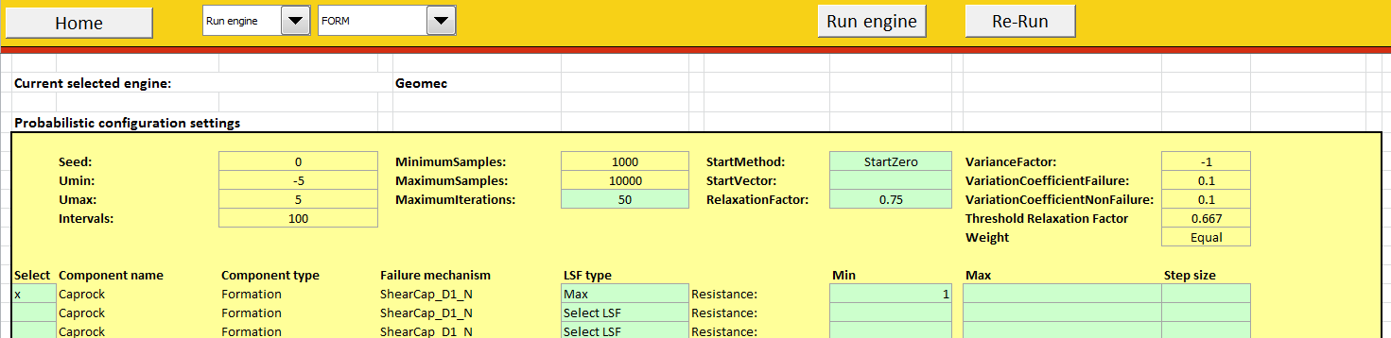
Reliability Analysis
Reliability analysis can be performed with the engine or proxy with possibly engine runs near failure.
Step 1: Select <Run engine> or <Run proxy>.
Step 2: Select components of interest and give limit value (range). In case of < Run proxy> the threshold should be given at which the engine is called. Threshold of 0 means no engine runs
Step 3: Choose the probabilistic methodology and set parameters.
Step 4: Check if <Reliability results> is empty. Run the analysis
Step 5: Check the results

Slide 15
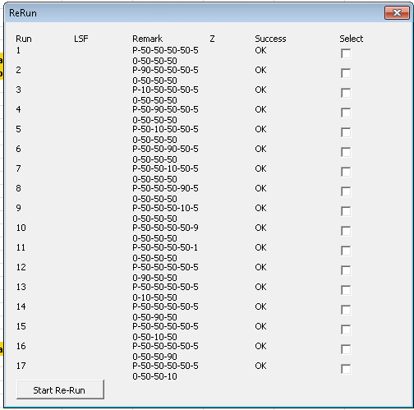
Rerun option
The re-run option allows you to rerun cases of interest from the quick screening or reliability analysis in parallel mode.
Step 1: Click the re-run button
Step 2: Select the csv file of the analysis
Step 3: Select the cases of interest and
press <Start Re-Run>

Slide 16
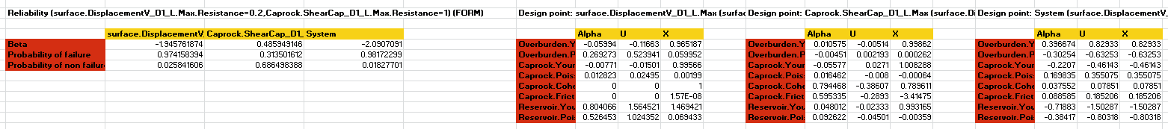
Reliability Results
  During calculation:
    The analysis can be traced via the log file and csv file. They are both regularly updated
  After calculation the result will be loaded in the <Reliability results> sheet, namely:
    Probability of failure per component and system failure
    Design point and vector per component
  Note 1: The reliability results will indicate method used and settings
  Note 2: All samples and results are stored in the csv file and rerun of samples is possible.

Slide 17
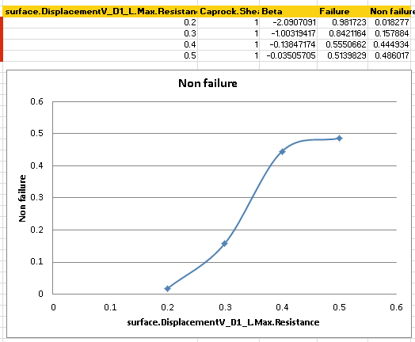
Fragility
Fragility describes how the outcome (probability of failure or allowable limit) changes with change of the design parameters. This can be calculated by
Input an array for the allowable limit on the reliability sheet
Input an array for model parameters on the model sheet
The result is a table which relates
change in parameters to
change in probability of failure:

Slide 18
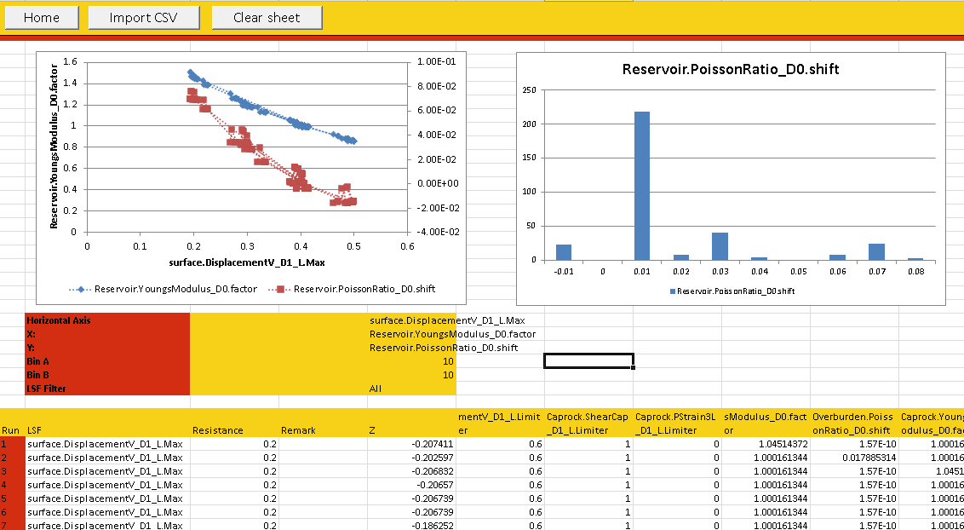
CSV viewer
Some standard plots can be viewed in CORA by:
Step 1: Load csv file of interest
Step 2: Change row and columns to liking

Slide 19
Best practices

Slide 20
General CORA best practice (1)
  <Home>
    Create a CORA project for different scenarios
    Define all objects of failure upfront
    You can copy and paste failure mechanisms after loading your model
  <Model sheet>
    Calculate and store on local disc (C:/Apps)
    New screening in new folder (old will be wiped otherwise)
    You can use browse pictogram to go to the created project folder
    Note that the base case values are only equal to the p50 when assuming symmetric distributions around base case values.
    Correlated stochasts preferably have similar distributions
    Deselecting or adding stochasts requires updating of the correlation table

Slide 21
General CORA best practice (2)
  < Scenario sheet>
    Note that the choice of proxy can result to dependencies between objects and stochasts which are physically not related or that sequence change results in different outcomes. This is the result of the fitting procedure. This should resolve in automatic procedure for reliability calculations
    When your results have disappeared, try <Validate and continue> in the previous sheet after calculations have ended.

